Slide 1
Gen_3 model objective functions

Slide 2
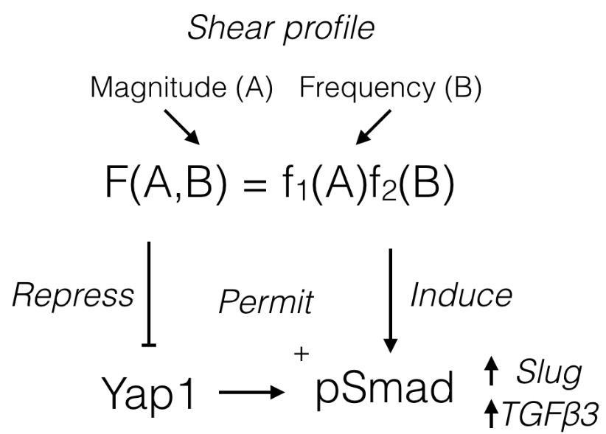
Mechanics, yap

Slide 3
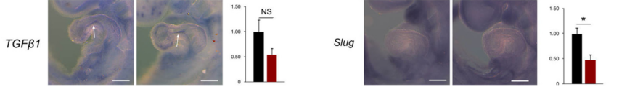
Zhang H 2014, Yap1 is required for endothelial to mesenchymal transition of the atrioventricular cushion.
Figure 4 Loss of YAP1 leads to reduced expression of endocardial EMT markers.
qPCR with yap1 loss

Slide 4
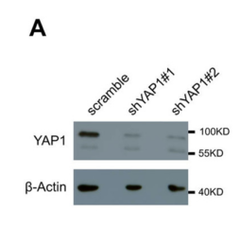
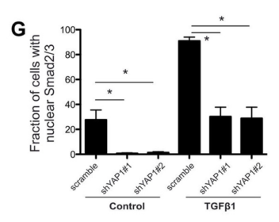
Zhang H 2014, Yap1 is required for endothelial to mesenchymal transition of the atrioventricular cushion.
Figure 5 YAP1 regulates cell migration in vitro and mediates Smad2/3/4 nuclear entry
Loss of psmad 2/3 localization (no effect on 1/5/8 shown in J)
Validation data?

Slide 5
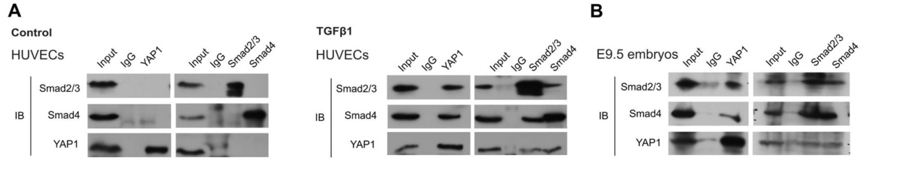
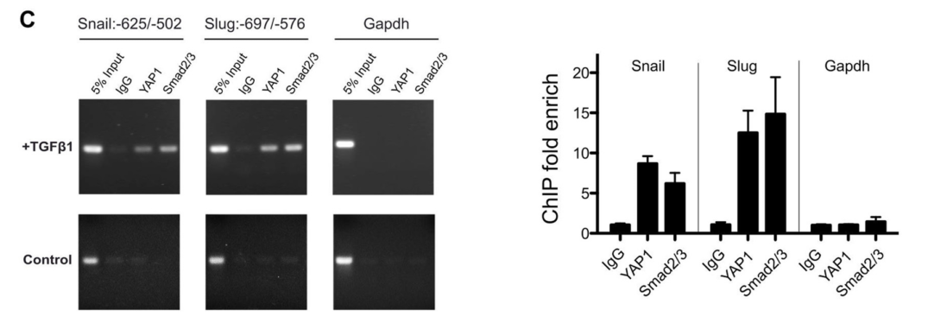
Zhang H 2014, Yap1 is required for endothelial to mesenchymal transition of the atrioventricular cushion.
Figure 6 YAP1 interacts with Smad2/3/4 to regulate EMT genes
Immunoblot & ChIP promoter activation with snail slug treatment
Panel C shows transcriptional regulation of YAP1 by TGFB1
Results describe refs 42,43, smad2/3/4
Activating snail/slug

Slide 6
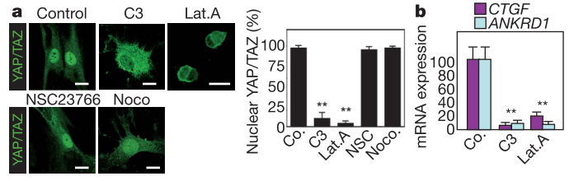
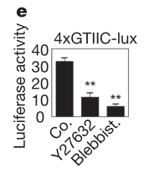
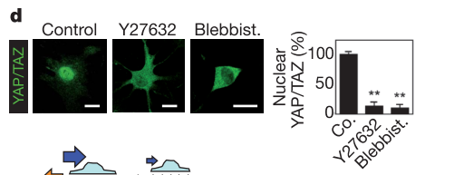
Dupont S, 2011 Role of YAP/TAZ in mechanotransduction.
Figure 2: YAP/TAZ activity requires Rho and tension of the actin cytoskeleton
Try to find evidence of Yap activity varying with mechanical loads
Yap/taz reporter

Slide 7
PECAM YAP1 THROUGH AKT?
https://scholar.google.com/scholar?hl=en&as_sdt=0%2C33&q=%22PECAM%22+akt&btnG=
Sphingosine kinase-1 enhances endothelial cell survival through a PECAM-1–dependent activation of PI-3K/Akt and regulation of Bcl-2 family members
http://www.bloodjournal.org/content/105/8/3169.short?sso-checked=true
Akt Phosphorylates the Yes-Associated Protein, YAP, to Induce Interaction with 14-3-3 and Attenuation of p73-Mediated Apoptosis
https://www.sciencedirect.com/science/article/pii/S1097276502007761?via%3Dihub
https://www.ncbi.nlm.nih.gov/pubmed/?term=14-3-3+YAP

Slide 8
Shear stress drives PECAM more evidence + PECAM ->akt
MAPKs (ERK½, p38) and AKT Can Be Phosphorylated by Shear Stress Independently of Platelet Endothelial Cell Adhesion Molecule-1 (CD31) in Vascular Endothelial Cells*
http://www.jbc.org/content/280/12/11185.short
Role of PECAM-1 in the shear-stress-induced activation of Akt and the endothelial nitric oxide synthase (eNOS) in endothelial cells.
https://www.ncbi.nlm.nih.gov/pubmed/16118242

Slide 9
PECAM also sequesters Bcat?
PECAM-1 (CD31) functions as a reservoir for and a modulator of tyrosine-phosphorylated beta-catenin

Slide 10
Cilia

Slide 11
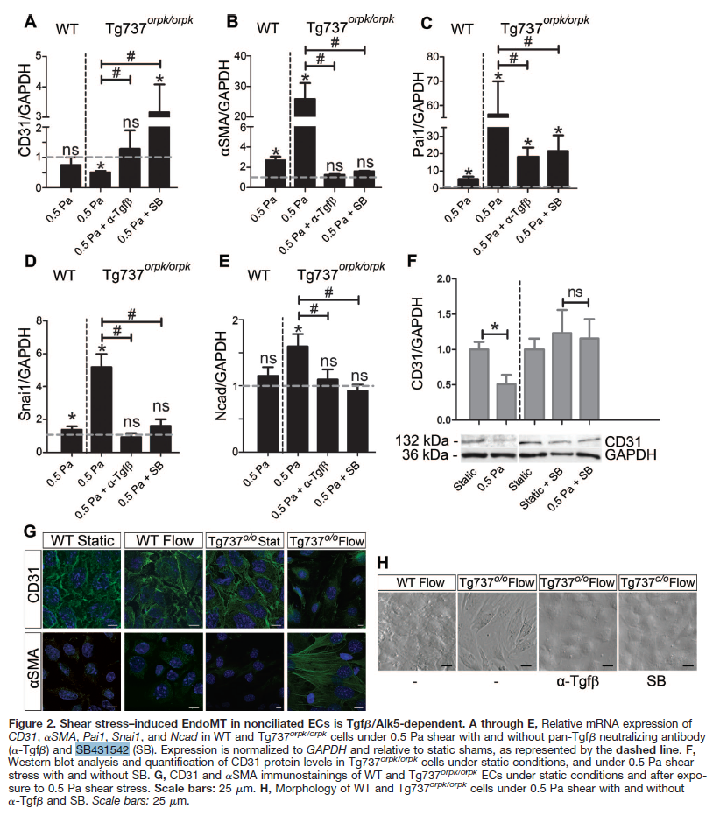
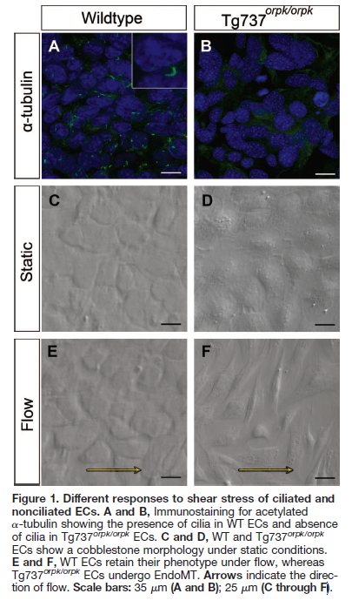
MOUSE EMBRYONIC ECs
Egorova, A. 2011 Lack of primary cilia primes shear-induced endothelial-to-mesenchymal transition
Figure 1 shows endothelial disruption after loss of cilia and exposure to shear ; Figure 2 shows responses to shear stress (0.5 Pa SS / 5 dyn/cm^2)
Panels show CD34, ACTA2(aSMA), and snai1 expression

Slide 12
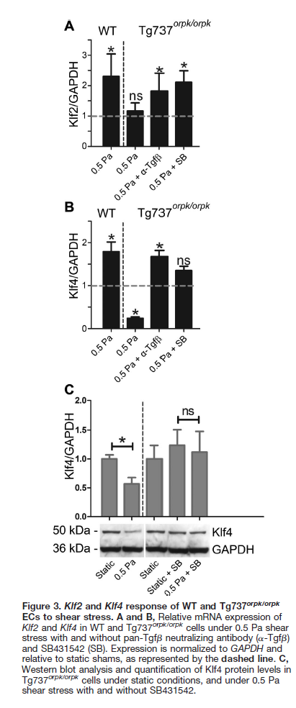
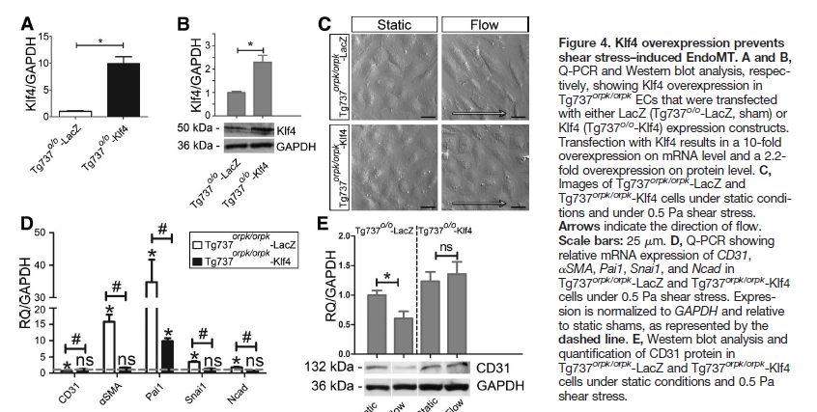
Egorova, A. 2011 Lack of primary cilia primes shear-induced endothelial-to-mesenchymal transition
Figure 3 (right column) elevation in klf2 expression under WT shear (this is associated with the stable phenotype
Figure 4 (below) KLf4 is protective against shear induced EndMT / it prevents SS induced EMT
3
Panels
4

Slide 13
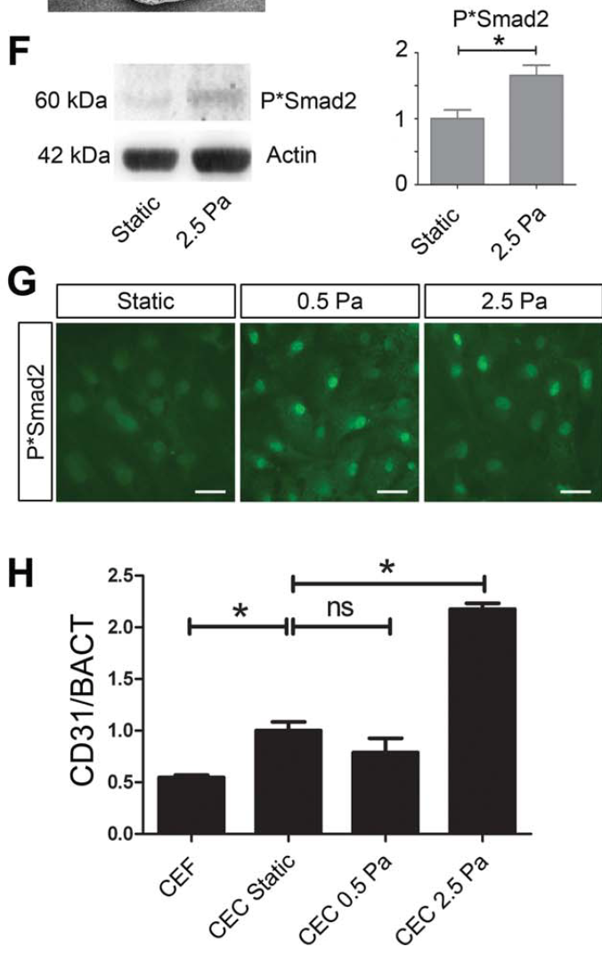
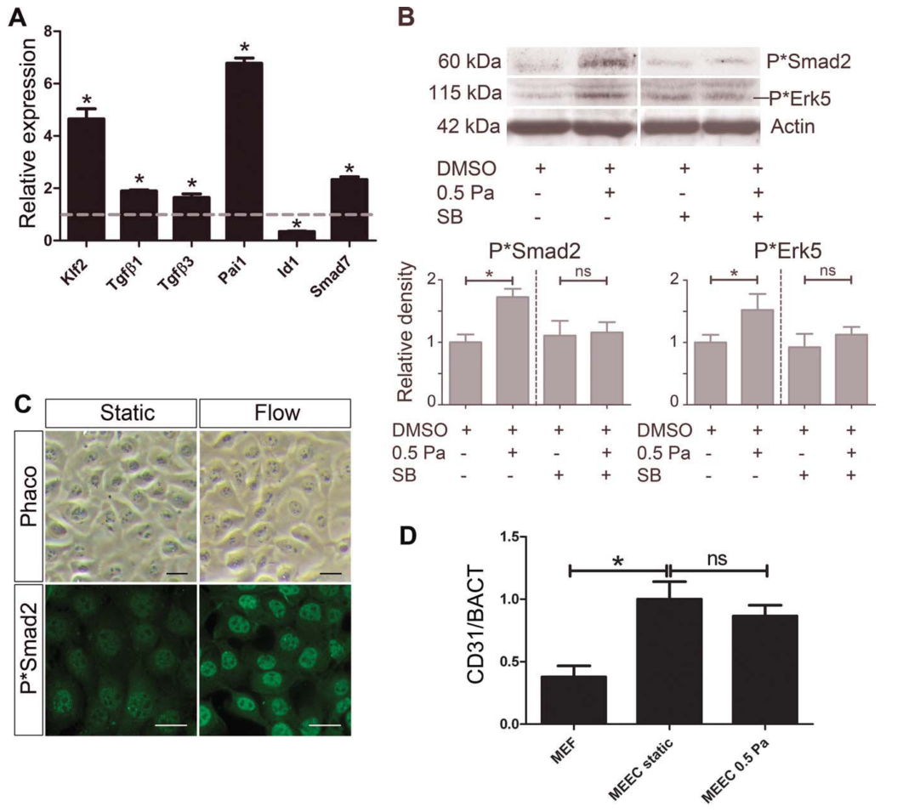
Egorova, A. D. 2011 (2) Tgfβ/Alk5 signaling is required for shear stress induced klf2 expression in embryonic endothelial cells.’
Figure 1 pSmad nuclear localization with steady state flow, decreasing at 2.5Pa
Figure 2 pSmad and Erk activation reduced with alk inhibitor (SB)
1
2
MOUSE EMBRYONIC ECs
CHICK EMBRYONIC Ecs (source check methods)

Slide 14
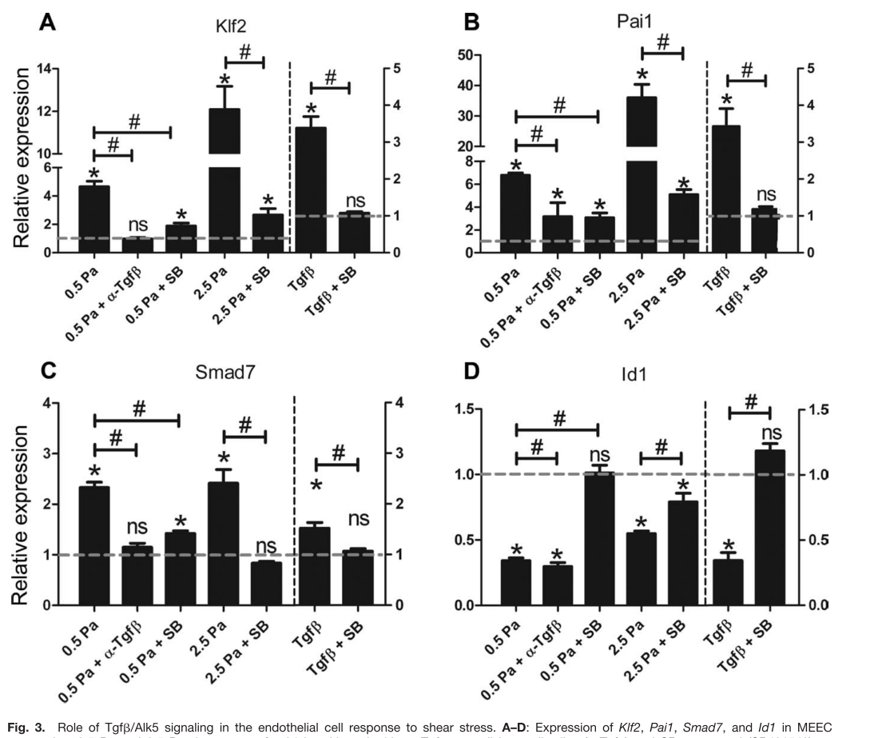
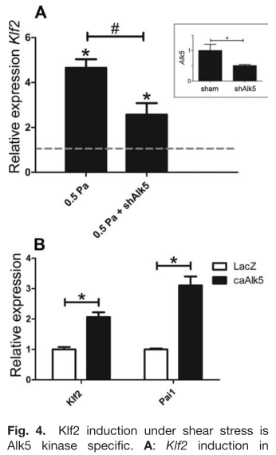
MOUSE EMBRYONIC ECs
Egorova, A. D. 2011 (2) Tgfβ/Alk5 signaling is required for shear stress induced klf2 expression in embryonic endothelial cells.’
Figure 3 alk5 inhibitor effects on Klf2 and Smad7
Figure 4 alk5 specificity
3
Panels
4

Slide 15
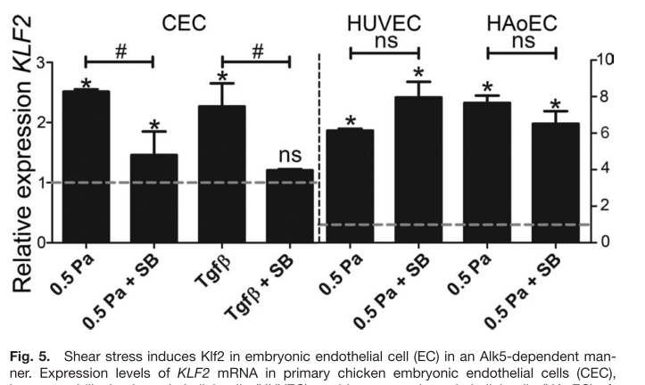
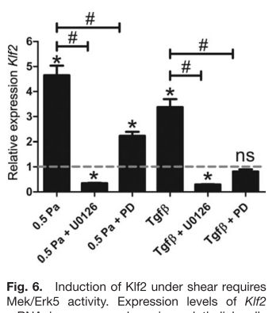
MIXED CELL SOURCES,
CEC either at HH40 or 17
Egorova, A. D. 2011 (2) Tgfβ/Alk5 signaling is required for shear stress induced klf2 expression in embryonic endothelial cells.’
Figure 5 alk 5 dependent klf2 activation by shear stress, TGFb also induces klf2 directly
Figure 6 TGFb induces klf2 via MAPK (Mek5/Erk5)
5
Panels
6

